Slide 1
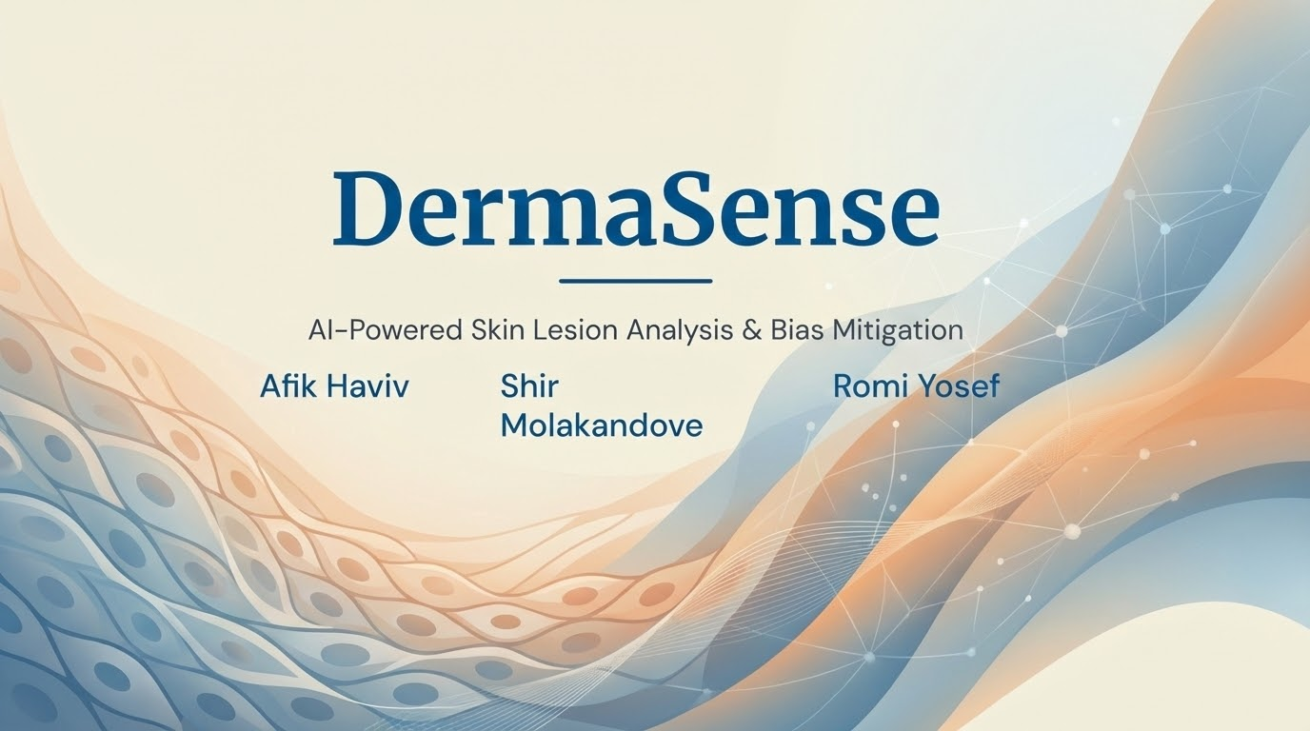
DermaSense
AI-Powered Skin Lesion Analysis & Bias Mitigation
Afik Haviv
Shir Molakandove
Romi Yosef

Slide 2





Project Review
Motivation
Evolution
Novelty
The Gap: Medical datasets are severely biased towards light skin, causing AI to fail on darker skin tones.
From Proposal: Shifted from simple "data generation" to a rigorous Validation Pipeline.
Innovation: A safe Hybrid Pipeline (SDXL Texture + Poisson Blending) that avoids hallucinations.
The Pivot: We now prove utility by training two models (Biased vs. Diverse) in a head-to-head comparison.
The Goal: Eliminate this bias using synthetic data to ensure equitable cancer detection.
Contribution: Created a high-fidelity "Digital Skin Bank" for Fitzpatrick Type VI.

Slide 3
Previous Work & Literature Review
Title / Year | Task | Methods | Data | Results | Relation to Project
Dermatologist-level classification of skin cancer... Esteva et al. (2017) | Binary Classification (Benign vs. Malignant) | Deep CNN (Inception v3), Transfer Learning | 129,450 clinical images (Private dataset) | AUC comparable to 21 board-certified dermatologists. | Serves as the Benchmark for deep learning performance capabilities.
Synthetic Data Augmentation using GANs... Rashid et al. (2020) | Dataset Expansion via Synthesis | Generative Adversarial Networks (GANs) | ISIC Public Dataset | Increased accuracy and reduced overfitting. | Foundational Method: Validates using synthetic data to fill data gaps.
Addressing Bias in Skin Cancer Classification... Daneshjou et al. (2022) | Bias Evaluation & Reduction | Tone-focused data augmentation | Diverse sets (Western + Asian + African) | Diversity corrects error rates on darker skin. | Core Innovation: Inspires our focus on synthetic dark skin to ensure fairness.

Slide 4



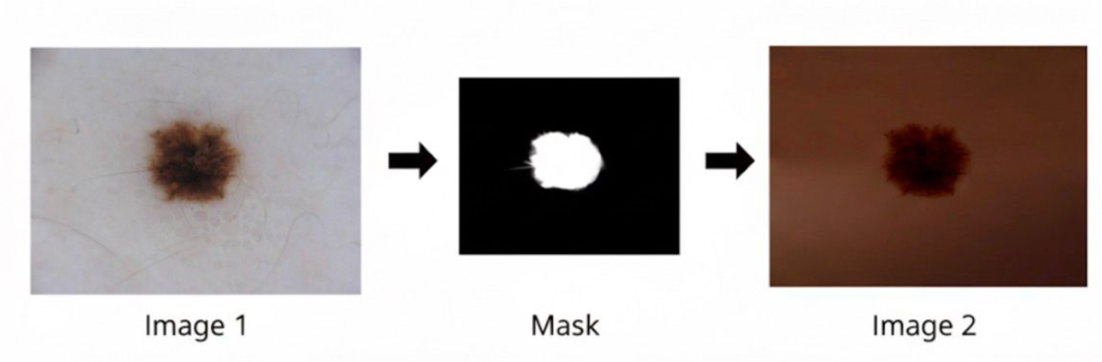

Dataset Creation & Analysis
1. The Dataset
2. Techniques
3. EDA (Exploratory Data Analysis)
Goal: Correct bias in ISIC 2016.
Hybrid AI Pipeline:
•
Generated: Synthetic extension for Fitzpatrick Type VI (Dark Skin).
•
Generation: SDXL 1.0 (Texture) + Medical Prompting.
•
Class Balance: Perfect 50/50 split (Benign/Malignant).
•
Composition: Merged Original lesions with synthetic dark backgrounds.
•
Segmentation: U²-Net (Rembg) for precise masks.
•
Resolution: Generated @ 1024px → Resized to 224px.
•
Blending: Poisson editing for seamless integration.

Slide 5


Evaluation Results: Dark Skin Test Set
Metric | Biased Model (Standard) | Diverse Model (Ours) | Improvement
Accuracy | ~82% | ~95% | +13%
Recall (Safety) | ~54% | ~96% | +42%
F1-Score (Balance) | ~52% | ~92% | +40%
The Baseline Failure
The Diverse Success
The Standard Model achieved only 54% Recall on dark skin, meaning it missed nearly half of the malignant cases, posing a significant safety risk.
Our Diverse Model achieved a massive 96% Recall, successfully identifying the vast majority of cancer cases, with a balanced F1-Score of 92%.

Slide 6
Project Roadmap & Plan
Step | Description / Scope | Status | Outcome
1. Bias Replication | Train standard ResNet50 on ISIC 2016 (Light Skin) and validate failure on dark skin test set. | Done | Baseline Metrics
2. Data Generation | Generate synthetic Fitzpatrick Type VI skin using SDXL. Scale up from pilot sample to full dataset. | In Progress | Full Synthetic Dataset
3. Training & Optimization | Train Diverse Model on mixed dataset using Class-Weighted Loss to penalize false negatives. | In Progress | Robust Model
4. Final Evaluation | Head-to-Head Comparison (F1-Score, Recall) on held-out Dark Skin Test Set. | Next Step | Final Proof Graph
5. Final Delivery | Prepare final presentation, documentation, and code delivery. | Pending | Project Completion
Technical Scope & Models: PyTorch Framework • ResNet50 (Binary Classification) • Stable Diffusion XL (SDXL 1.0) for Texture Generation • U²-Net (Rembg) for Segmentation • OpenCV (Seamless Clone) for Image Compositing • Weighted Cross-Entropy Loss.

